Slide 1
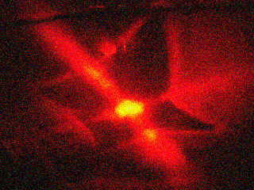
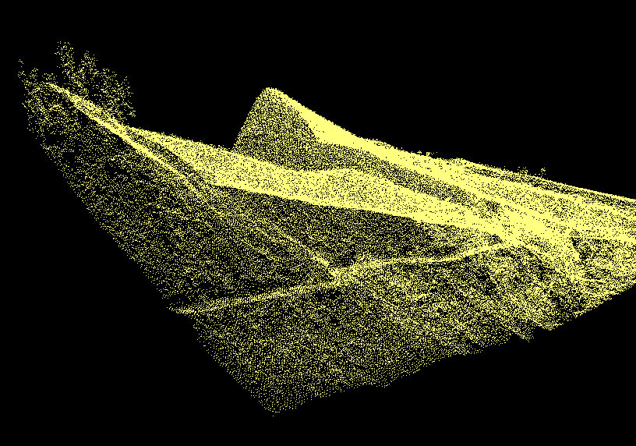
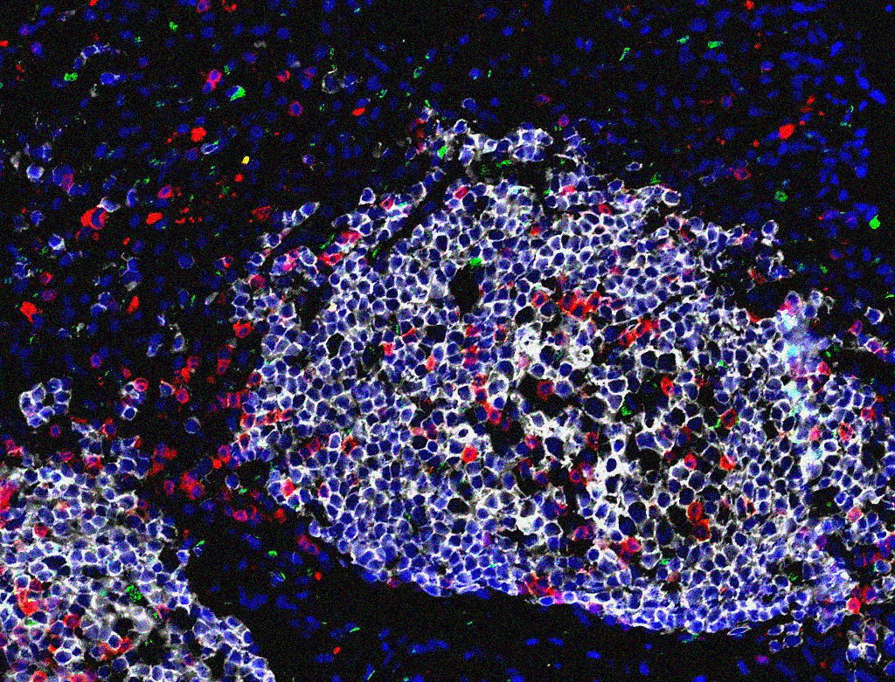
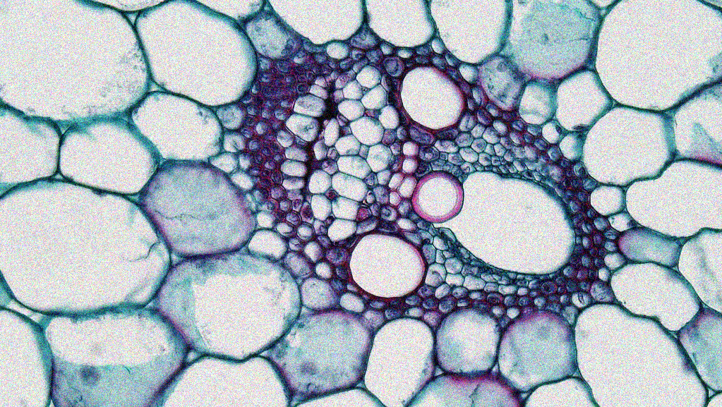
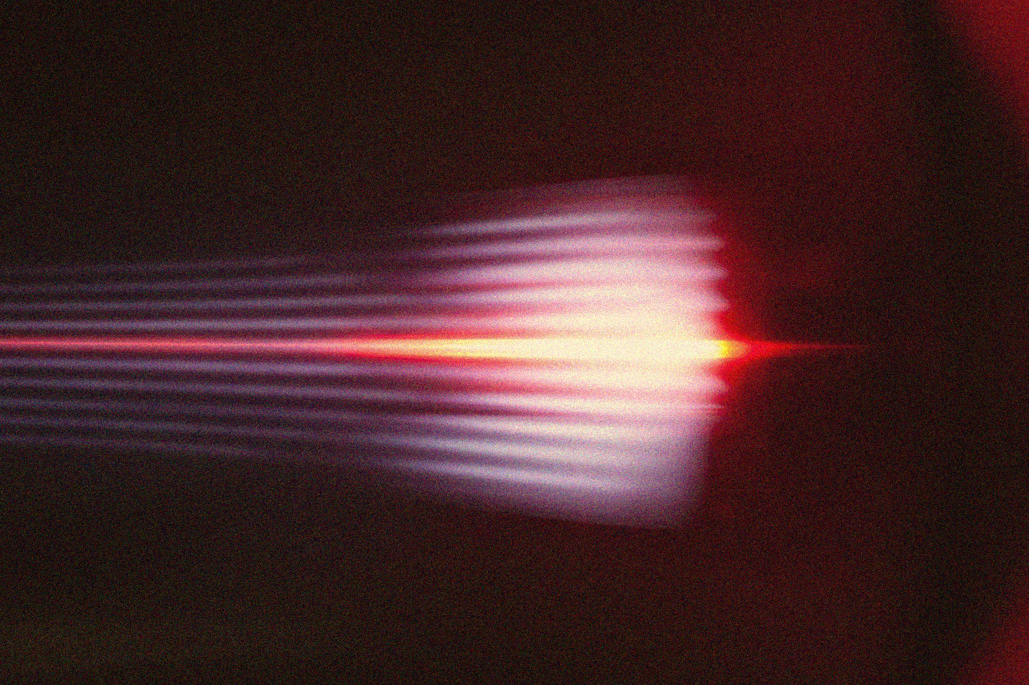
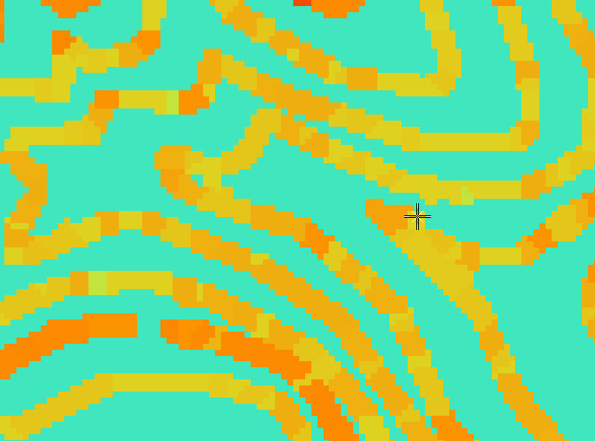
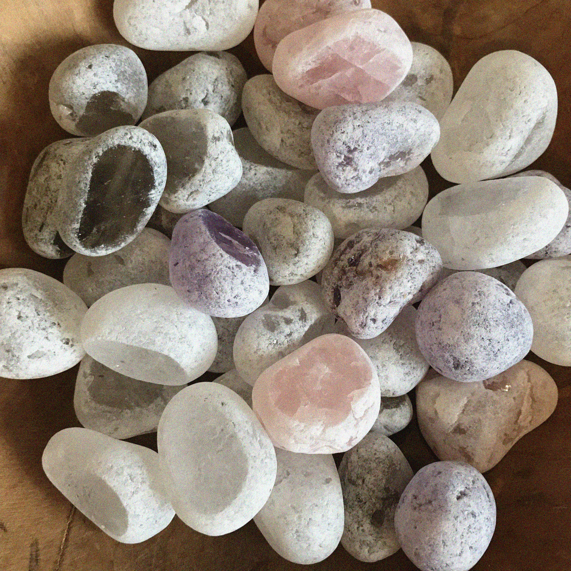
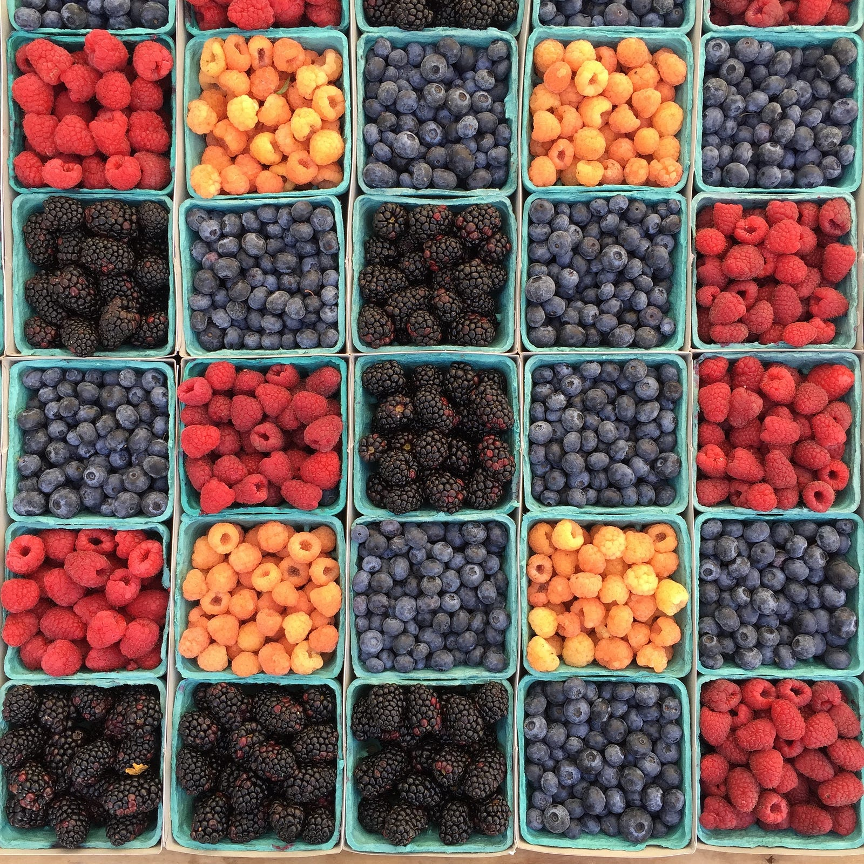

APP PHYSICS 157
COMPUTATIONAL ANALYSIS AND MODELLING
MORPHOLOGICAL OPERATIONS
IMAGE AND VIDEO PROCESSING – MODULE 1
NINO PHILIP RAMONES | GITHUB
2020 – 05616
JULY 1, 2023
This Photo by Unknown Author is licensed under CC BY-NC-ND

Slide 2
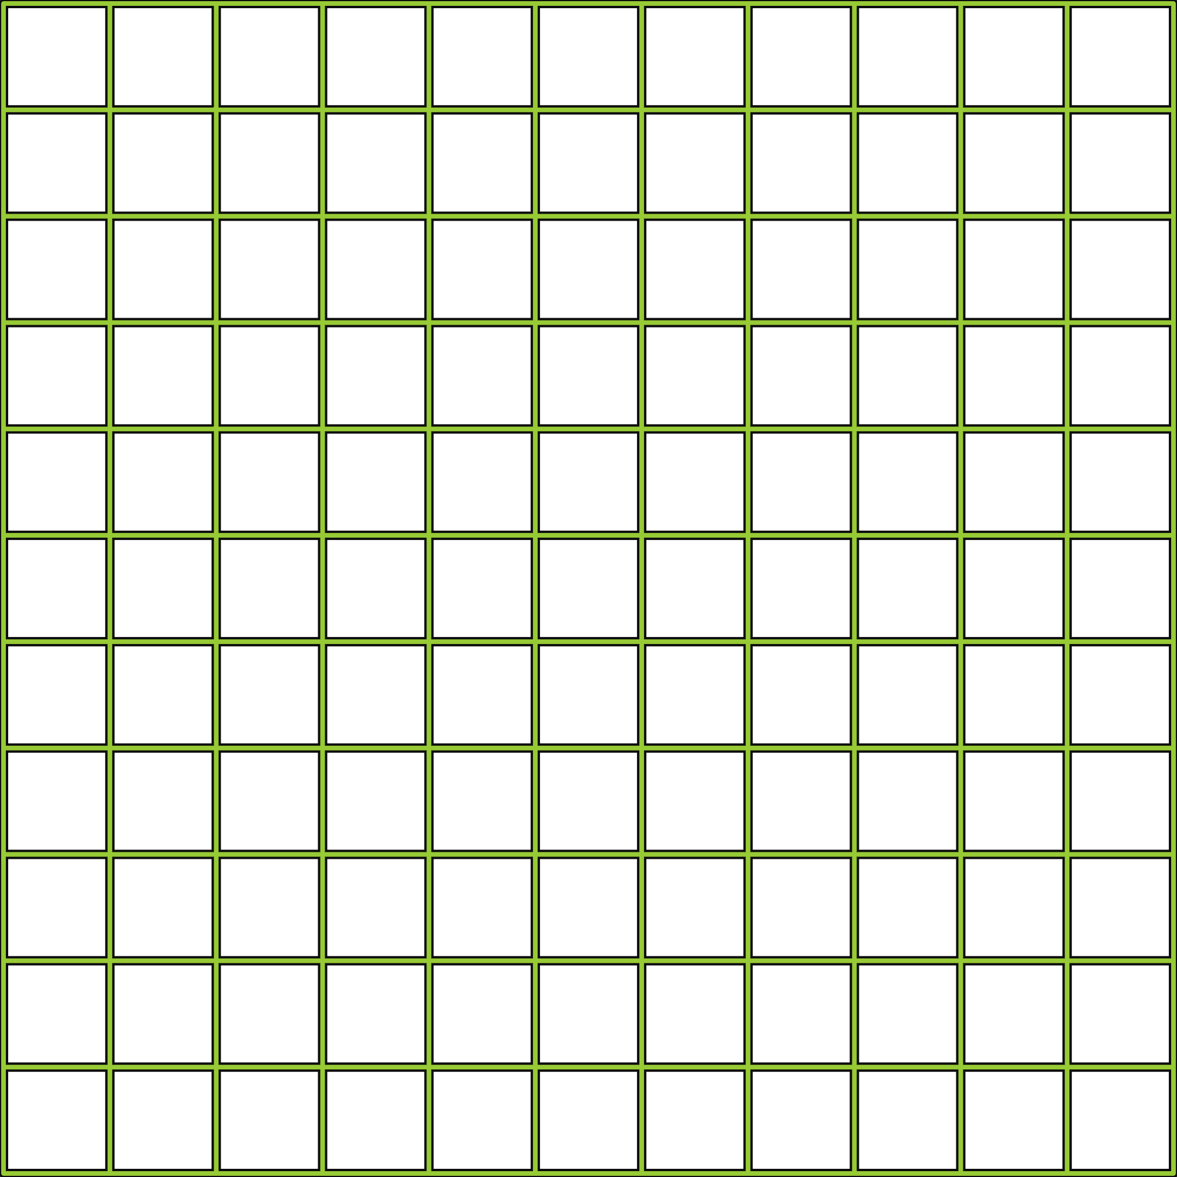
APP PHYSICS 157
MORPHOLOGICAL OPERATIONS
OBJECTIVES
Perform morphological operations on different structuring elements to see how the resulting shape is formed based on the set origin and operation
Apply morphological operations to clean thresholded and segmented images for feature extraction
KEY TAKEAWAYS
Morphological operations are useful in cleaning a segmented image and eliminating unwanted details on the image prior to extracting the features of interest on every element on the image, while also preserving the shape and size of objects in the image
Knowing what type of morphological operation to apply on the image is important depending on the characteristic of the segmented image
SOME PITFALLS
Setting the origin on the image for the structuring element is important as shifting on the area being removed or retained differs based on the origin
Performing morphological cleaning on an image might distort and remove some of the details of the cells prior to feature extraction and analysis

Slide 3
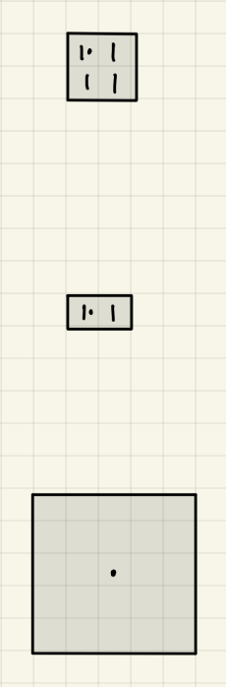
APP PHYSICS 157
MORPHOLOGICAL OPERATIONS
STRUCTURING ELEMENTS
In this activity, structuring elements of varying shapes and sizes were considered. In general, a structuring element is a shape used to interact with a given image where it is tested whether it fits or misses a portion of an original element or shape in the context. The following structuring elements were initialized to test our understanding on the different morphological operations –-- using pen and paper!
A two-by-two square whose origin is on the upper left, a one by two rectangle with the left box as the origin, and a five-by-five square with the center as the origin were set as the structuring elements. Different shape forms were tested on these which will be shown on the succeeding slides.
Figure 1. Structuring elements used in the activity. Output can be viewed in this file link.

Slide 4
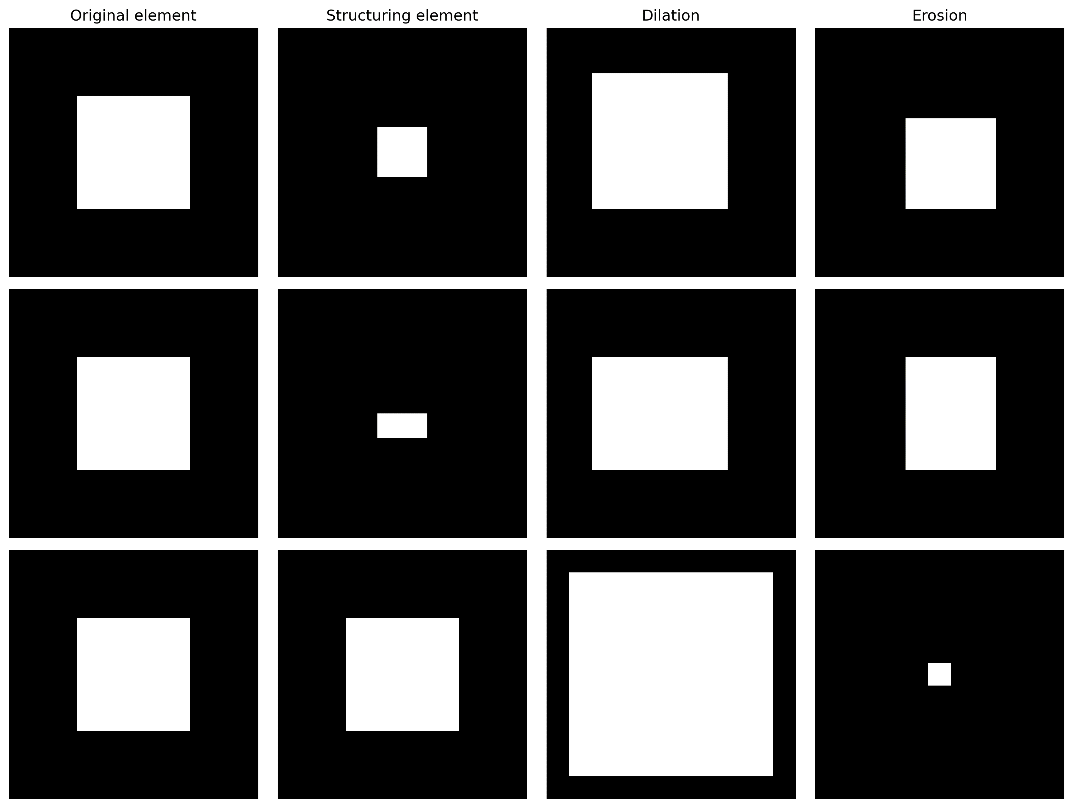
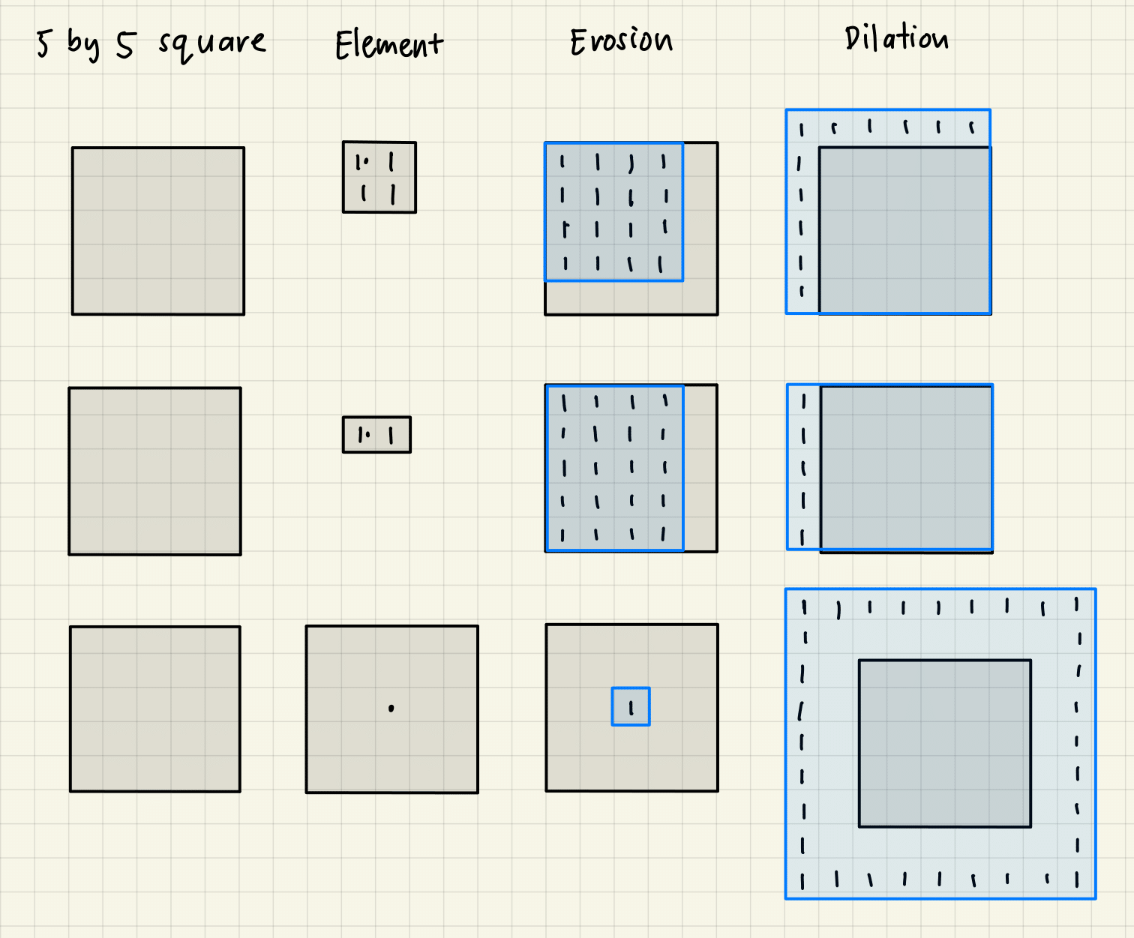
APP PHYSICS 157
MORPHOLOGICAL OPERATIONS
FIVE BY FIVE SQUARE
Figure 2. Dilation and erosion operators performed on a five-by-five square using three different structuring elements. The results from scratch (right) were compared to the results obtained after using skimage.morphology library in Python.

Slide 5
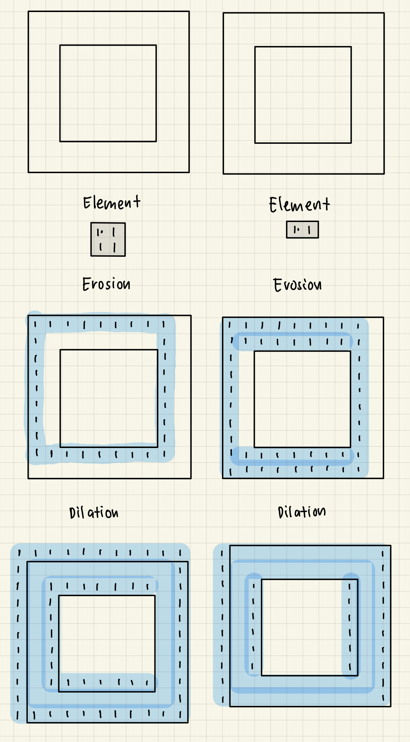
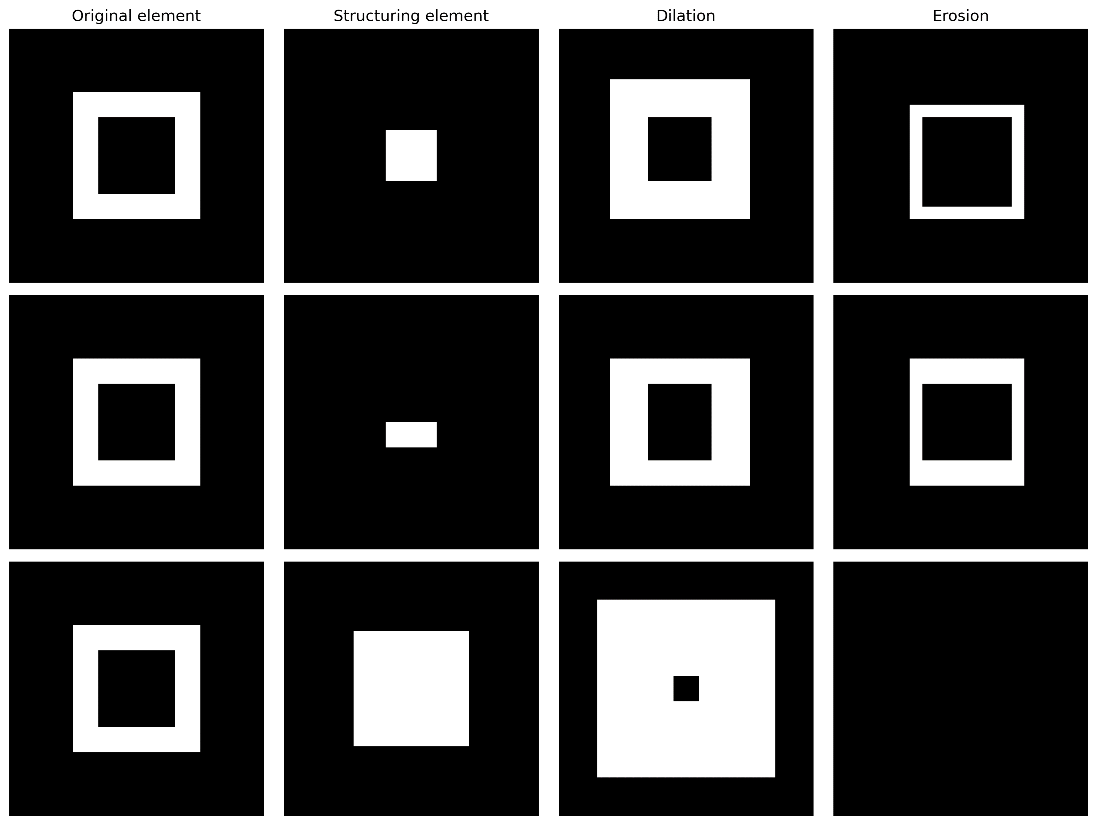
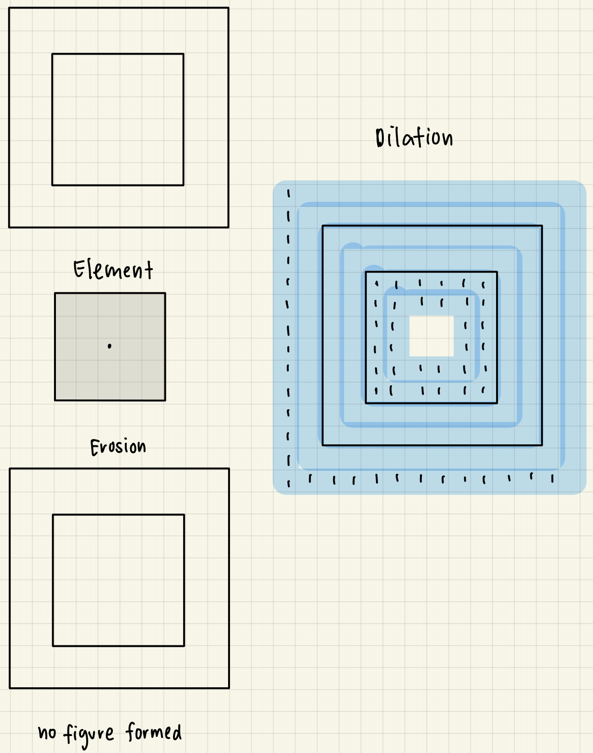
APP PHYSICS 157
MORPHOLOGICAL OPERATIONS
HOLLOW 10 X 10 SQUARE
Figure 3. Dilation and erosion operators performed on a hollow ten-by-ten square using three different structuring elements. The results from scratch (right) were compared to the results obtained after using skimage.morphology library in Python.

Slide 6
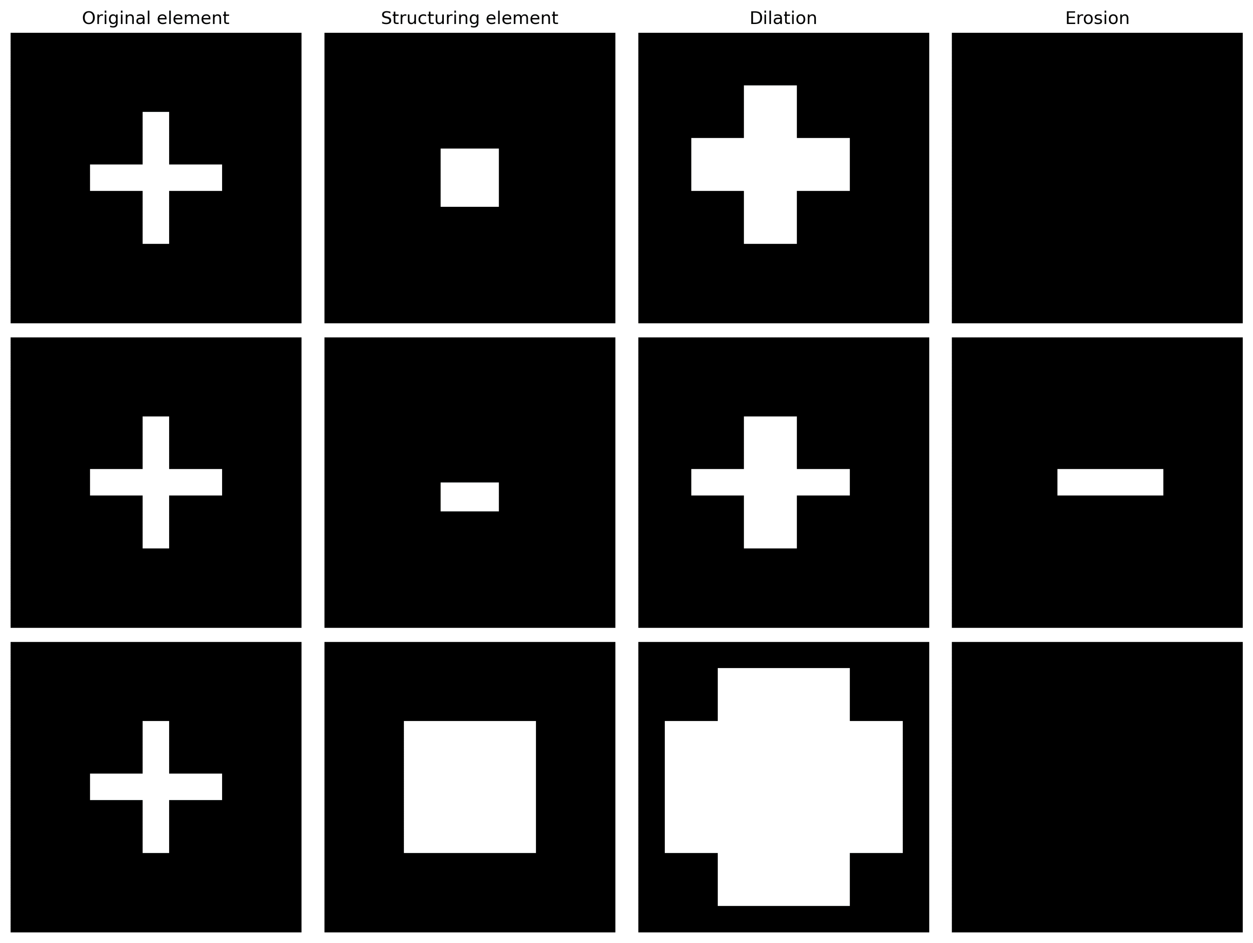
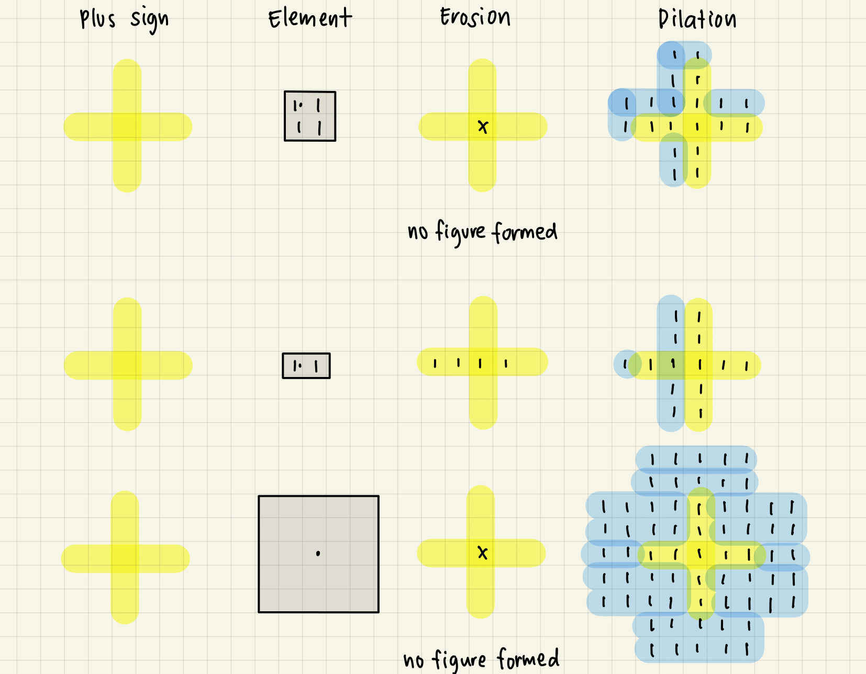
APP PHYSICS 157
MORPHOLOGICAL OPERATIONS
FIVE BY FIVE CROSS ACROSS AXIS
Figure 4. Dilation and erosion operators performed on a five-by-five cross or plus sign using three different structuring elements. The results from scratch (right) were compared to the results obtained after using skimage.morphology library in Python.

Slide 7
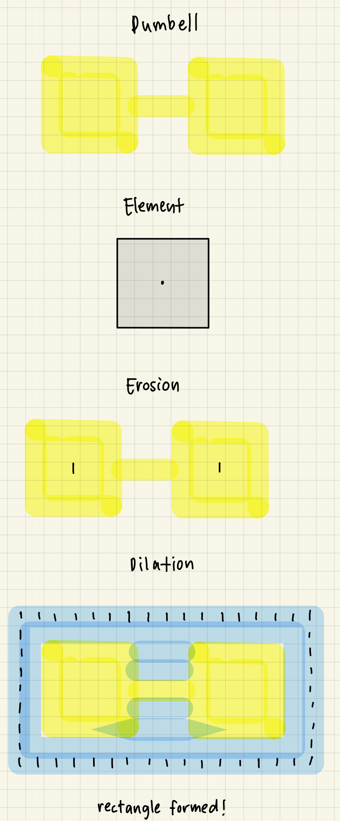
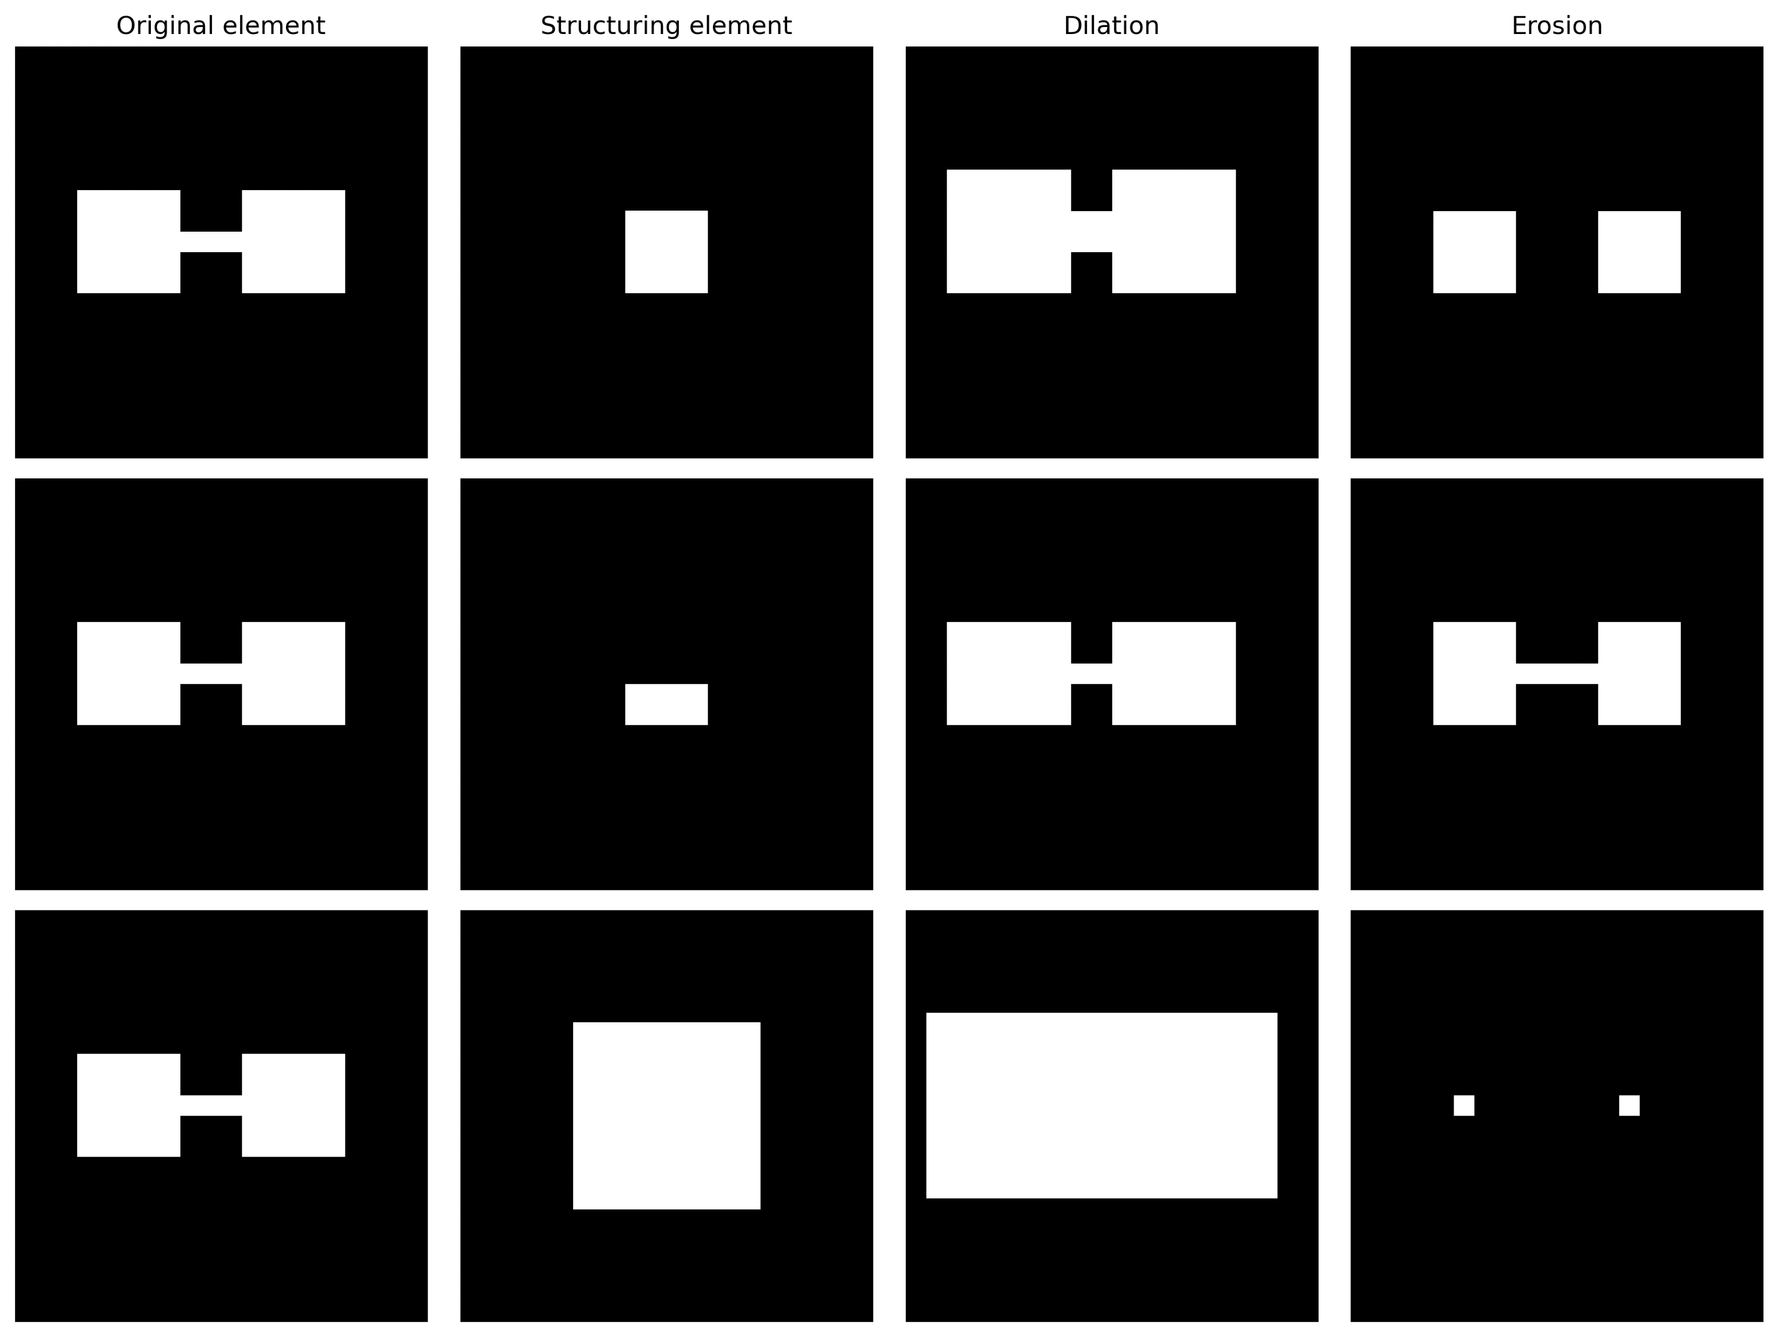
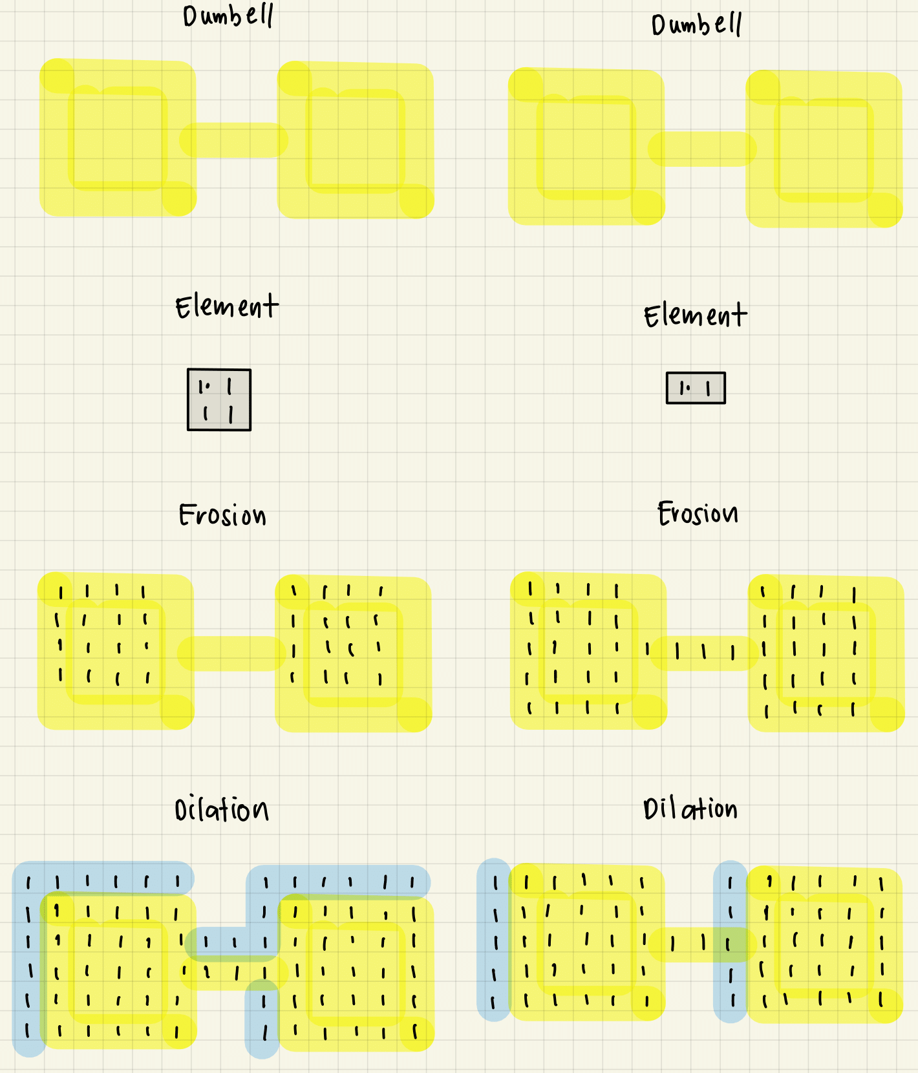
APP PHYSICS 157
MORPHOLOGICAL OPERATIONS
DUMBELL SHAPE
Figure 5. Dilation and erosion operators performed on a dumbbell-shaped element using three different structuring elements. The results from scratch (right) were compared to the results obtained after using skimage.morphology library in Python.

Slide 8
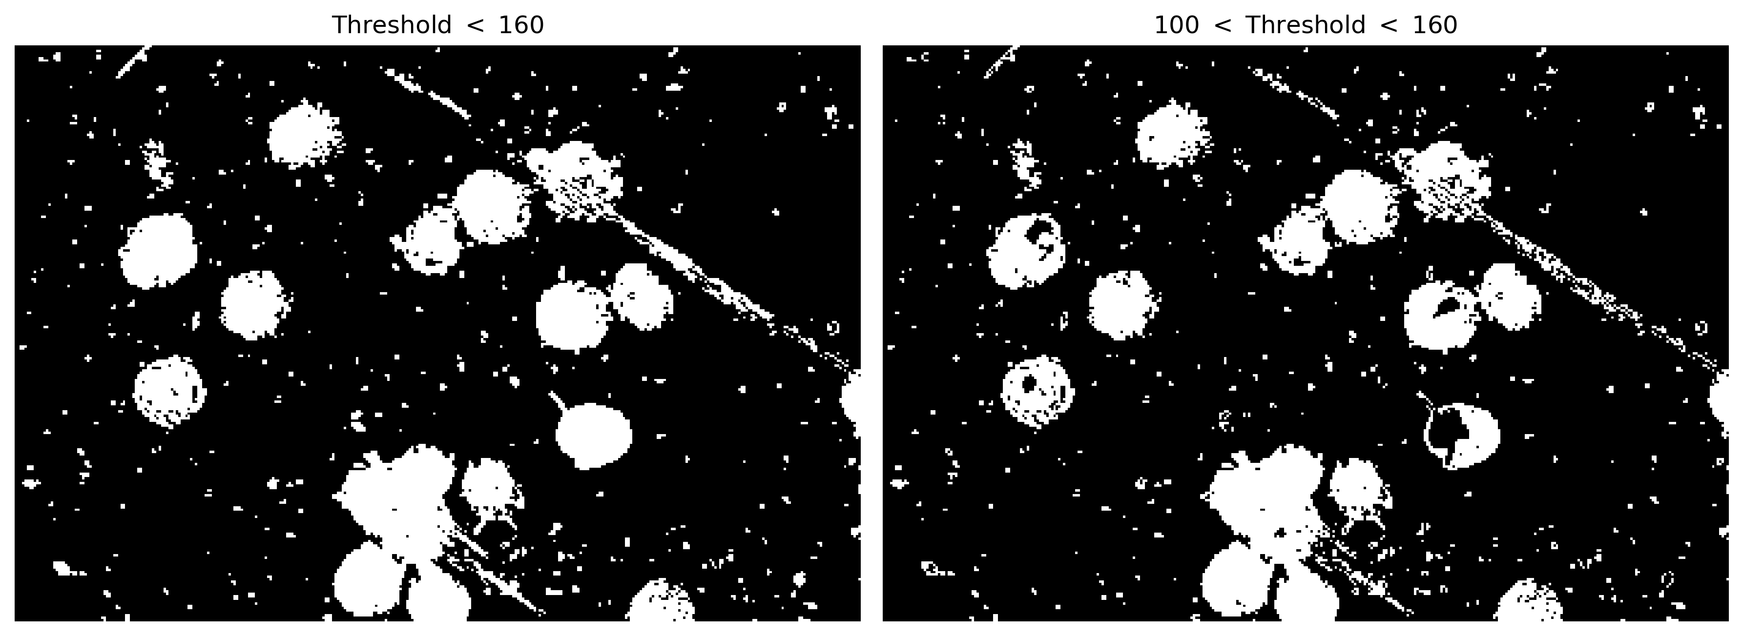
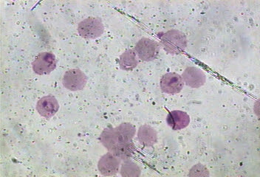
APP PHYSICS 157
MORPHOLOGICAL OPERATIONS
MORPHOLOGICAL CLEANING
Employing the same principle on segmenting images through thresholding, we performed morphological cleaning on the malaria samples to isolate unwanted details on the segmented image.
Figure 6. Thresholded image of the malaria cells for varying threshold or clipping values.
From the figure, the image was segmented by choosing a certain pixel value on the grayscale histogram of the original image, and clipping values above it to zero such that the resulting image only contains the regions of interest, i.e. the cells or blobs present. It can be noticed that the thresholded image contains a lot of dots that are unwanted for feature extraction since we only want to observe the cells itself. This is where the process of cleaning through morphological operations come into play!

Slide 9
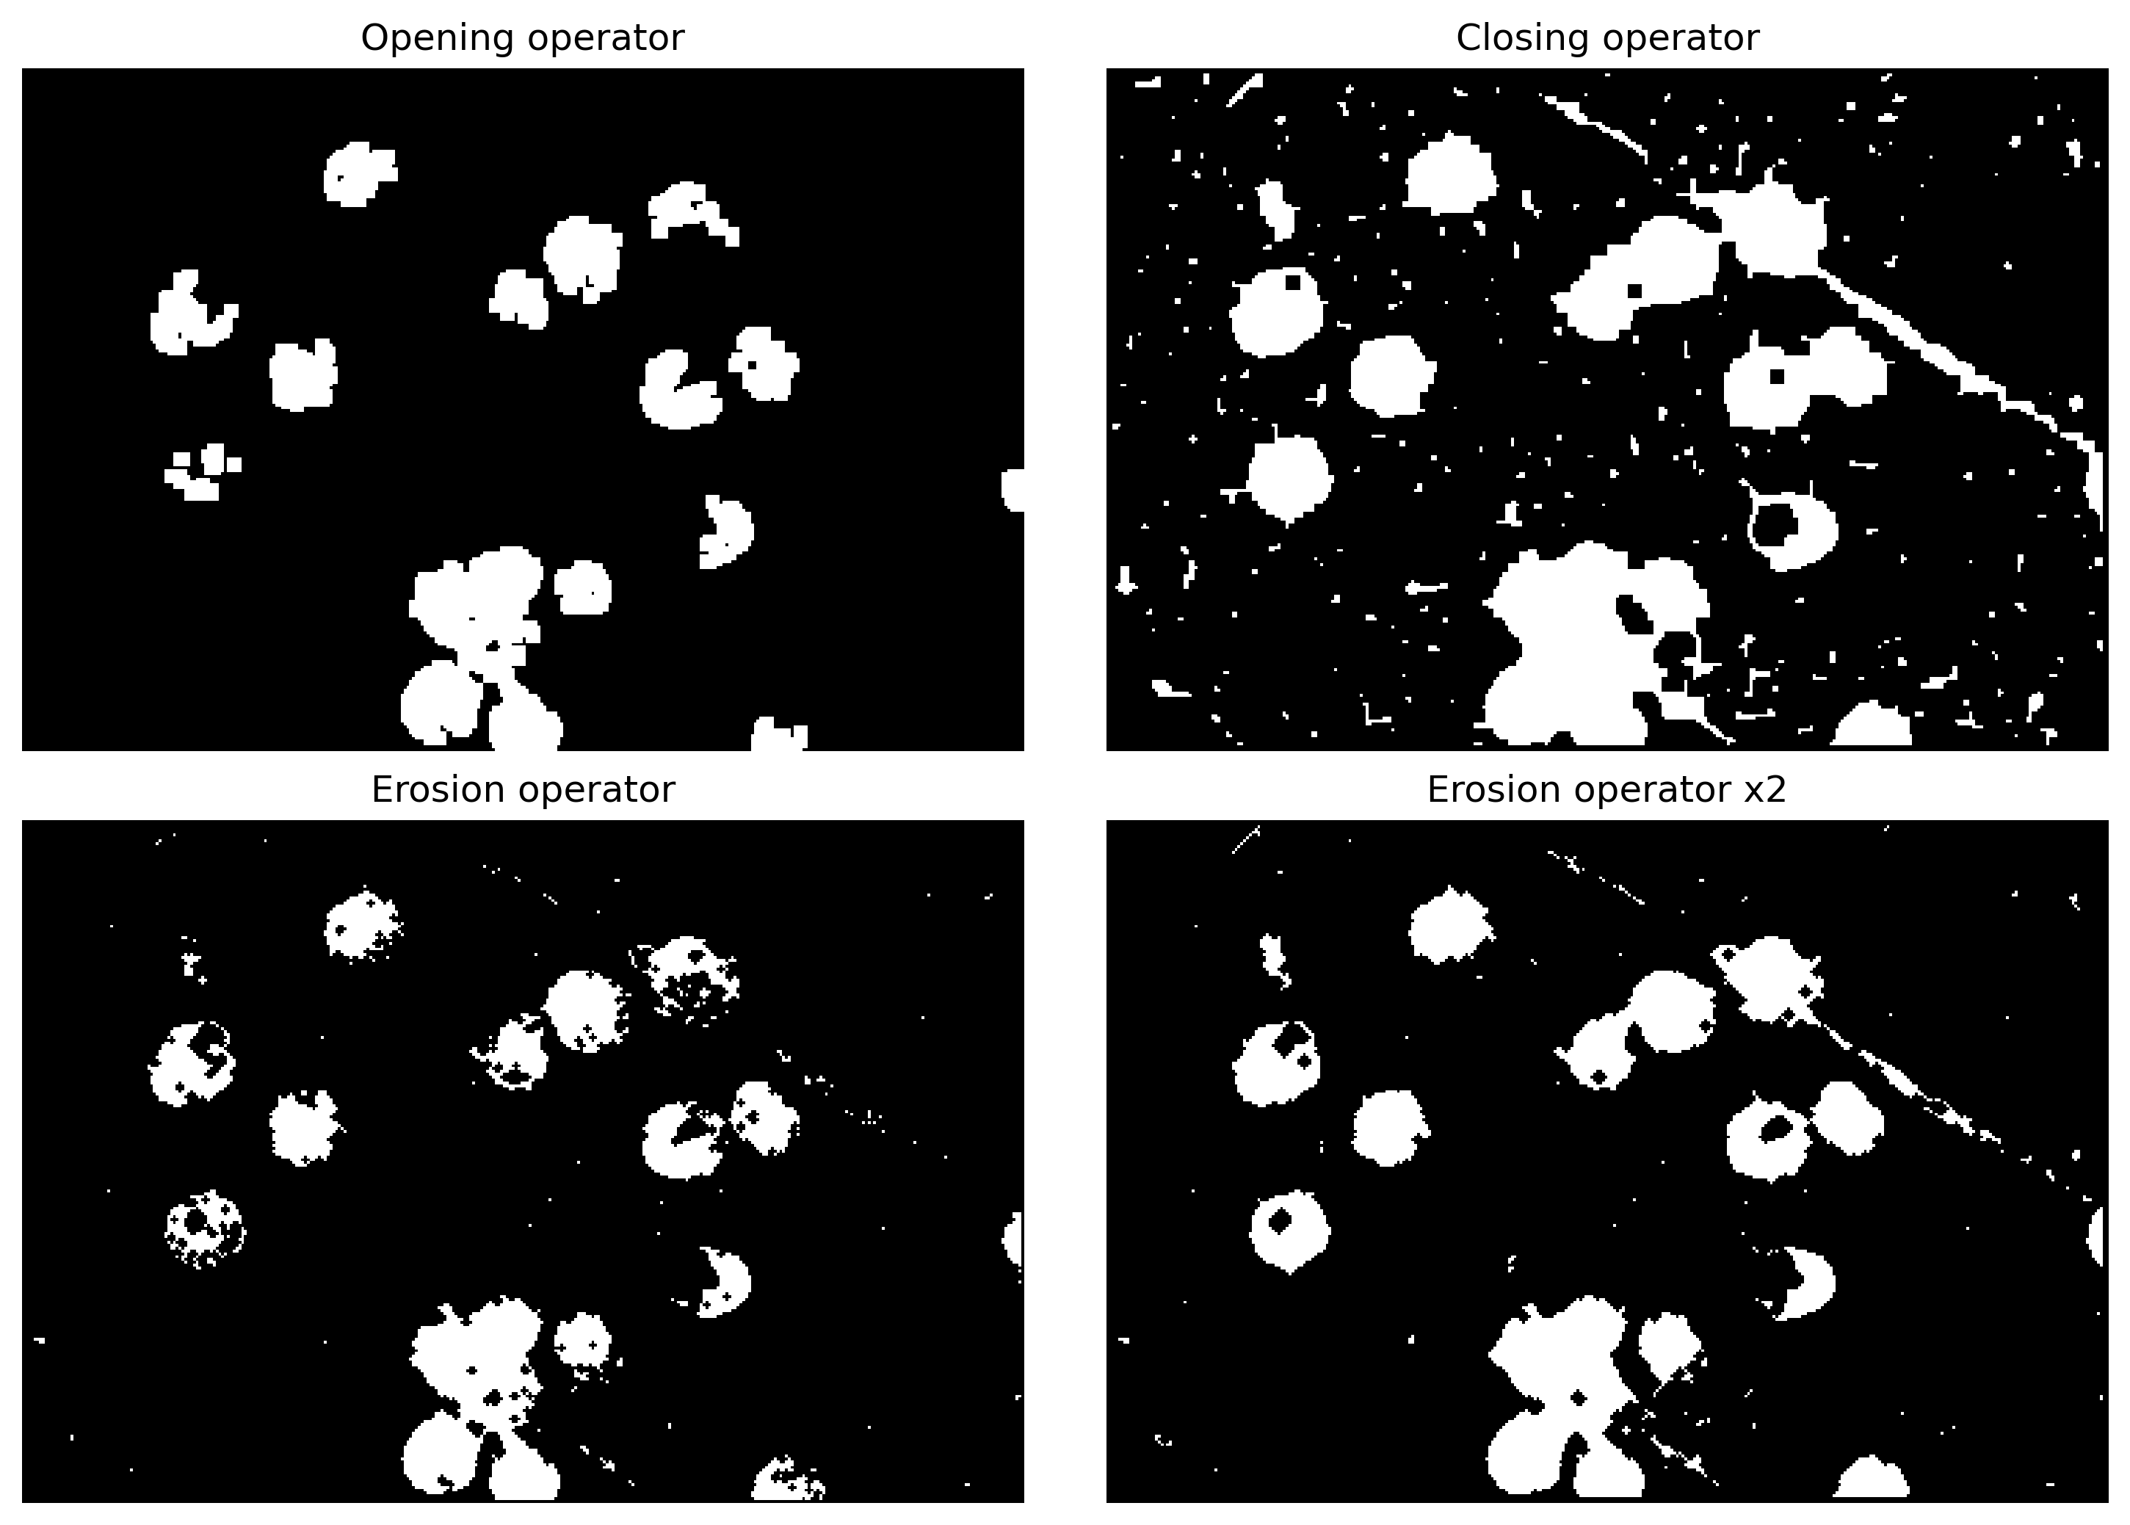
APP PHYSICS 157
MORPHOLOGICAL OPERATIONS
MORPHOLOGICAL CLEANING
Figure 7. Morphologically-cleaned image of the malaria cells after thresholding.
After thresholding the image, a series of different morphological operations were performed to experiment and see how the white dots gradually disappear resulting to a much cleaner and more detailed image.

Slide 10
APP PHYSICS 157
MORPHOLOGICAL OPERATIONS
MORE ON OPERATIONS
By inspection, the opening operator yielded an ideal image that can be used for feature extraction itself as it no longer contains the unwanted white spots previously. Although the shape of most cells were sort of distorted and irregular in general, the morphological cleaning was still able to do its job in cleaning the image! But what do these opening and closing operators really do?
Figure 8. Opening operator applied.
Opening operator. This operation erodes an image and then dilates the eroded image while also using the same structuring element for both operations. This is useful for removing small objects and thin lines on an image while also preserving the shape and size of larger objects or blobs in the image.
Closing operator. This operation dilates an image and then erodes the dilated image while also using the same structuring element for both operations. This is useful for filling small holes on an image while also preserving the shape and size of larger objects or blobs in the image.

Slide 11
APP PHYSICS 157
MORPHOLOGICAL OPERATIONS
REFLECTION
I find the activity fun as I get to work and understand the principle behind morphological operations. The results that I obtained on the code and paper were similar, although a slight shifting on the axis was observed on the code results as I was not able to set the proper origin given in the activity. Nonetheless, I was still able to deliver what is expected on the activity and account for the pitfalls that I have encountered in my codes. Overall, I would give myself a score of 110/100 !
REFERENCES | GITHUB
M. Soriano, Applied Physics 157 – Morphological Operations, 2023.
Types of Morphological Operations - MATLAB & Simulink (mathworks.com)
skimage.morphology — skimage 0.21.0 documentation (scikit-image.org)

